Slide 1
CLUB ACTIVITIES
2024 -2025

Slide 2
LOVELY SINGING CLUB
WEEK 1 Class: I - A&B DATE :05.02.25
Topic : Science fun
Learning Outcome:To explore the science in our environment and to learn simple experiment through this science song.

Slide 3
LOVELY SINGING CLUB
WEEK 2 Class: I - A&B DATE :12.02.25
Topic : Science fun
Learning Outcome:To explore the science in our environment and to learn simple experiment through this science song.

Slide 4
LOVELY SINGING CLUB
WEEK 4 Class: I - A&B DATE :26.02.25
Topic : Science fun
Learning Outcome:To explore the science in our environment and to learn simple experiment through this science song.

Slide 5
DISASTER MANAGEMENT CLUB
WEEK 1 Class VII A & C DATE :05.02.25
Topic : Discussion on Project Work to the students.
Activity: Students to prepare a Project about Man-Made Disaster Management.
Learning Outcome: Students will come to know about the Various types of Man-Made Disasters.

Slide 6
DISASTER MANAGEMENT CLUB
WEEK 2 Class VII A & C DATE :12.02.25
Topic : To manage and take preventive steps for Man –Made Disasters & Role of Disaster Agencies in India.
Activity: Students will prepare the project with suitable pictures and write- ups.
Learning Outcome: Students will be equipped to handle the situation and approach to the appropriate Disaster Agencies in the real life situation

Slide 7
DISASTER MANAGEMENT CLUB
WEEK 4 Class VII A & C DATE :26.02.25
Topic : Presentation and Submission of the Project.
Activity: Student to submit his/her project.
Learning Outcome: Students will gain overall knowledge and idea about Disaster Management skill and techniques. This Club ensures the students can face any type of Disaster challenges in future. This Club ensures that Peer coordination and cooperation is well accomplished.

Slide 8
HERITAGE CLUB
WEEK 1 Class IV B DATE :05.02.25
Topic : Jaisalmer Desert Festival.
Activity: Children learn about the famous heritage festival of desert
area in India through video.
Learning Outcome:To understand the richness and colourful Rajasthani folk culture.

Slide 9
HERITAGE CLUB
WEEK 2 Class IV B DATE :12.02.25
Topic : Making of Rajasthan Puppet.
Activity: Origami activity using newspaper, white clay, Acrylic colours- red and black, 2 different origami coloured sheets, glue and
scissors.
Learning Outcome: To develop hand, eye, arm, finger and body coordination. Also to be creative and expressive.

Slide 10
HERITAGE CLUB
WEEK 4 Class IV B DATE :26.02.25
Topic : Report Writing.
Activity: To write a report on heritage club in Scrapbook.
Learning Outcome: Recognise how to plan and focus on a process for writing such documents in order to equip you with the strategies and skills that will help to write more efficiently.

Slide 11
WEEK 1 Class IV A
DATE :05.02.25
Topic : Modular Origami
Activity : Lotus
Learning Outcome: Engaging in the precise and
repetitive motions of origami can be meditative and helps reduce stress.

Slide 12
WEEK 2 Class IV A
DATE :12.02.25
Topic : Modular origami
Activity : Wall hanging
Learning Outcome : Folding precise and intricate
designs require focus and
concentration, enhancing
mental clarity.
.

Slide 13
WEEK 4 Class IV A
DATE :26.02.25
Topic : Clay Art
Activity: Miniature art ( fridge décor and magnet)
like ice cream , donut etc.
Learning Outcome : Working with clay develops
patience and concentration.
It also improves visualization skill.
.

Slide 14
HEALTH AND WELLNESS CLUB
WEEK 1 Class VIII A & C DATE :05.02.25
Topic : Vaccination or Immunisation.
Activity: Video clips showing to the students by giving suitable information about vaccines, it’s schedule and about the diseases.
Learning Outcome:EPI – Implement services to ensure the immunisation of all vulnerable age groups by preventively reaching out before the contact and develop infectious diseases.

Slide 15
HEALTH AND WELLNESS CLUB
WEEK 2 Class VIII A & C DATE :12.02.25
Topic : AI applied in health care system
Activity: PPT to students which makes more predictive and proactive by analysing big data to develop improved preventive health care.
Learning Outcome:Students will get educated on the drug designing, bio signalling done in AI system.

Slide 16
HEALTH AND WELLNESS CLUB
WEEK 4 Class VIII A & C DATE :26.02.25
Topic : Feedback about Health and wellness Club
Activity: Group discussion and feedback on practising of club activities by students.
Learning Outcome:To promote hygienic lifestyles
among students.

Slide 17
CLUB
WEEK 1 CLASS : III A,B,C DATE : 05.02.25
Topic : Gardening - Visiting to the nearby nursery
Activity : Children will be taken to the nursery garden, they will be witnessing the different types of plants.
Learning Outcome: Students will learn about seeds and how seeds move around in nature to help grow food, flowers, trees, and other plants. Students will learn the that birds act as seed dispersers. An appreciation for the importance of seeds might be nurtured.

Slide 18
CLUB
WEEK 2 CLASS : III A,B,C DATE : 12.02.25
Topic : Gardening - Guest lecturer from nursery garden
Activity : Guest lecturer from nursery garden will be visited.
Learning Outcome: Students will understand basic principles, processes and functions of plant growth and reproduction, including photosynthesis, respiration, transpiration, vegetative growth and reproductive growth, fertilization and fruit formation.

Slide 19
CLUB
WEEK 4 CLASS : III A,B,C DATE : 22.02.25
Topic : Feedback for hobby club.
Activity : Students will give their review about what they have learnt in hobby club throughout the year.
Learning Outcome: The exploration of hidden talents happens through hobby classes. Every person is born with a unique set of skills and abilities. But it is unfortunate that often they are not explored due to the set monotonous regular routines. So when a student join a hobby
class for some activity for which he has a natural inclination, he will not only enjoy but
also excels in it.

Slide 20
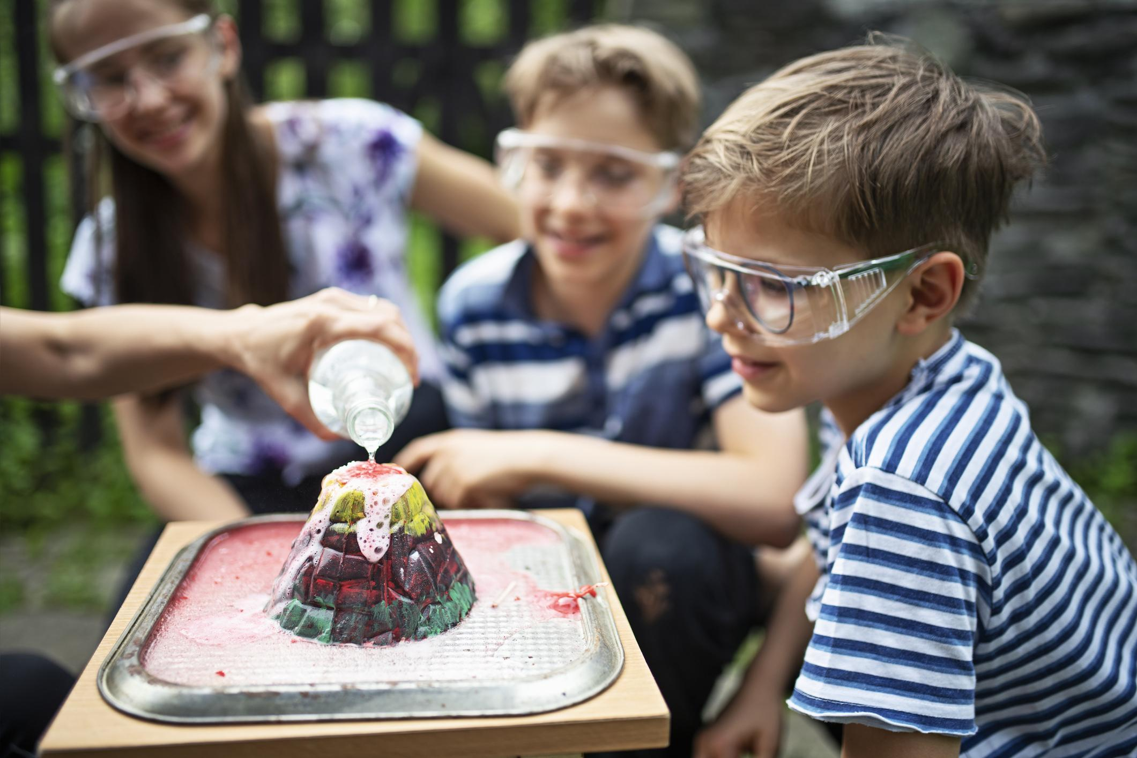
HOME SCIENCE CLUB
WEEK 1 CLASS : V B & C DATE : 05.02.25
Topic : Behaviour And Lifestyle
Activity : PPT related to Behaviour and Lifestyle.
Learning Outcome: Children will learn about life coping skills.

Slide 21
HOME SCIENCE CLUB
WEEK 2 CLASS : V B & C DATE : 12.02.25
Topic : Behaviour And Lifestyle
Activity : Role play – by giving different situations to think and respond. Children to enact the given topic.
Learning Outcome: Children will learn to express their views

Slide 22
HOME SCIENCE CLUB
WEEK 4 CLASS : V B & C DATE : 26.02.25
Topic : Trip to a Five star hotel.
Activity : Visit to a Five star hotel.

Slide 23
NATURE CLUB
WEEK 1 Class II A&B DATE :05.02.25
Topic : Nature Bookmark.
Materials Required: Leaves,Flowers, Any 2 colours of a5 chart, 1mtr of thread, Gum.
Activity: The students will be involved in an activity of making a nature based
bookmarks.
Learning Outcome:Children will gain more knowledge about the bookmarks
and the importance.

Slide 24
NATURE CLUB
WEEK 2 Class II A&B DATE :12.02.25
Topic : Flower sun catches.
Materials Required: Dried flowers, Dried leaves, OHP sheet-1.
Activity: The kids will learn about gorgeous suncatcher and they also learn about
vibrant and beautiful flowers.
Learning Outcome:To get the hands-on experience on making a suncatcher. This
activity also helps the kids to develop their fine motor skills.

Slide 25
NATURE CLUB
WEEK 4 Class II A&B DATE :26.02.25
Topic : Paw mark making with clay and stencils.
Materials Required: Paw mark stencil of different animals (Medium size), A4 paper (4 Nos), Gum, Air dry clay(any 5 colour).
Activity: The students will be doing paw mark of different animals using clay and
stencil.
Learning Outcome: This activity can promote fine and gross motor skills, different grips, and control over their bodies.

Slide 26
LITERARY CLUB
WEEK 1 CLASS : VIII B DATE : 05.02.25
Topic : Script writing.
Activity : Students will be split into groups of five or six members. A student from each team will write the script and will be enacted the next week.
Learning Outcome:
*Unlocks creativity
*Improves dialogue writing skills

Slide 27
LITERARY CLUB
WEEK 2 CLASS : VIII B DATE : 12.02.25
Topic : Skit.
Activity : The students will enact the script written.
Learning Outcome:
*Builds confidence
*Improves verbal communications
*Articulate lines Encourages/Promotes Teamwork

Slide 28
LITERARY CLUB
WEEK 4 CLASS : VIII B DATE : 26.02.25
Topic : Recap of all sessions
Activity : Students will be asked to share their views about the club activities and discuss what
they had learnt throughout the sessions.

Slide 29
KARUNA CLUB
WEEK 1 Class V-C,D DATE :05.02.25
Topic : Vegetarianism and health benefits.
Activity :Teacher will explain about health benefits of vegetarianism using a PPT
Learning Outcome: Students will know about scientific facts about veganism and vegetarian way of life.

Slide 30
KARUNA CLUB
WEEK 2 Class V-C,D DATE :12.02.25
Topic : Say no to foreign products
Activity :Students should talk on the topic “Say no to foreign products” & “Benefits of Indian products than the foreign products”.
Learning Outcome: To promote the use of Indian- made products and boycott foreign goods as a means for the revival of indigenous industries and the promotion of Indian craftsmanship, thereby fostering a sense of national pride and self-reliance.

Slide 31
KARUNA CLUB
WEEK 4 Class V-C,D DATE :26.02.25
Topic : How to take care of animals during
summer season.
Activity :Videos, activities to be followed
to take care of animals.
Learning Outcome: Children will learn to develop sense of Empathy.

Slide 32
PHILATELY CLUB
WEEK 1 CLASS : VI to IX DATE : 05.02.25
Topic : Unscrambling words
Learning Outcome: The ice break activity helps children to apply their knowledge and skills to solve the given worksheet puzzle.

Slide 33
PHILATELY CLUB
WEEK 2 CLASS : VI to IX DATE : 12.02.25
Topic : All at sea
Learning Outcome: Children will enhance their knowledge about stamps based on All at sea.

Slide 34
PHILATELY CLUB
WEEK 4 CLASS : VI to IX DATE : 26.02.25
Topic : Discussion with Philatelist.

Slide 35
WEEK 1 CLASS : VI TO IX DATE : 05.02.25
Topic : Quiz on world famous Places and monuments across the world.
Activity : Using PPT, videos the quiz will be conducted. The types of rounds in this quiz are- Where to find the famous buildings, Important places in the world, Facts about the countries, Important events in the countries
Learning Outcome:
By learning about their country’s history and culture, students can develop a sense of belonging and identity. Historical places such as national monuments, battlefields, and landmarks can instil a sense of national pride and inspire students to become more involved in their communities.

Slide 36
WEEK 2 CLASS : VI TO IX DATE : 12.02.25
Topic : Quiz on world famous, Places and monuments across the world.
Activity : Using PPT, videos the quiz will be conducted. The types of rounds in this quiz are- Where to find the famous buildings, Important places in the world, Facts about the countries, Important events in the countries
Learning Outcome:
By learning about their country’s history and culture, students can develop a sense of belonging and identity. Historical places such as national monuments, battlefields, and landmarks can instil a sense of national pride and inspire students to become more involved in their communities.

Slide 37
WEEK 4 CLASS : VI TO IX DATE : 26.02.25
Topic : General discussion about activities conducted in a year.
Activity : General discussion will be made with the students about the quiz club, which was conducted for the whole year. Students would be appreciated for their involvement and participation in the club.
Learning Outcome:
Students will recap the activities conducted in a year.

Slide 38
WEEK 1 Class VI A&C DATE :05.02.25
Topic : Club Competition (Continued)

Slide 39
WEEK 2 Class VI A&C DATE :12.02.25
Topic : Feedback session.
Activity: Students will speak about their experience in
science club.
Learning Outcome: By sharing their experiences students
get to know others opinion.

Slide 40
WEEK 4 Class VI A&C DATE :26.02.25
Topic : Balloon powered car
Activity: A balloon- powered car is pushed forward by air escaping from a balloon, and it is fun and easy to build with materials that are readily available.
Learning Outcome: Students will learn that the air escaping the balloon demonstrates Newton's third law of motion: for every reaction there is an equal and opposite reaction.

Slide 41
SPORTS CLUB
WEEK 1 DATE : 05.02.25
Topic : Volleyball history & Rules and Regulations.
Activity : Specific warmup, rotation, teaching the skills, practicing the skills, lead up activity, warm down.

Slide 42
SPORTS CLUB
WEEK 2 DATE : 12.02.25
Topic : Friendly match
Activity : Volleyball competition will be conducted for girls and boys separately, house wise.

Slide 43
SPORTS CLUB
WEEK 4 DATE : 26.02.25
Topic : Watching Video.
Activity : Comparative study on skill set of national and international players.

Slide 44
VOLUNTEERING CLUB
WEEK 1 CLASS : X B DATE : 05.02.25
Topic : School Cleanliness
Activity :Learners will be divided into teams and sent to different wings inside our school campus, and
will help the staff to clean the school campus.
Learning Outcome:
Learners will direct their peers towards school cleanliness

Slide 45
VOLUNTEERING CLUB
WEEK 2 CLASS : X B DATE : 12.02.25
Topic : Skit
Activity : Learners will display a skit or a mime to create an awareness towards classroom cleanliness
Learning Outcome:
Learners will direct their peers towards classroom cleanliness

Slide 46
VOLUNTEERING CLUB
WEEK 4 CLASS : X B DATE : 26.02.25
Topic : Competition
Activity :Learners will be submitting their thesis on the survey undertaken in the
previous session and they will be presenting through a PPT.
Learning Outcome:
Learners will reflect and role-play their contribution on the cleanliness of the community.

Slide 47
WEEK 1 Class VI B DATE :05.02.25
Topic : Gender Bias
Activity: Gender bias is a type of unconscious bias, where someone may stereotype or hold preconceived notions about other individuals based
on personal.
Learning Outcome: Children will understand about sexuality, race, ethnicity, religion, class and other critical variables.

Slide 48
WEEK 2 Class VI B DATE :12.02.25
Topic : Bookmark.
Activity: The students will be asked to make bookmark on gender bias{ Competition }.
Learning Outcome: Analyze human interactions and
social/political systems using a “gender lens”.

Slide 49
WEEK 4 Class VI B DATE :26.02.25
Topic : Feedback and Review

Slide 50
TOURISM CLUB
WEEK 1 Class X A&C DATE :05.02.25
Topic : Quiz.
Activity: Picture based activity.
.Learning Outcome:The objective of this quiz is to showcase India's varied tourism products, architecture, culture, and cuisine and test the public knowledge of tourism.

Slide 51
TOURISM CLUB
WEEK 2 Class X A&C DATE :12.02.25
Topic : Storytelling.
Activity: Picture based activity.
.Learning Outcome:To encourage active participation and discussions among students. To explore more about Indian
Tourism.

Slide 52
TOURISM CLUB
WEEK 4 Class X A&C DATE :26.02.25
Topic : Mass media.
Activity: PPT will be shown to the students.
Learning Outcome:Students will learn application of multimedia in various tourism sub- domains such as tourism
marketing, tourism education, mobile tourism, etc.

